Slide 1
Business Transformation in the manufacturing industry
How information acquisition, analysis,
usage and distribution affects the success of Lifecycle-Product-Service-Systems
by
Schuh, G. ; Gudergan, G.; Feige, B. A.; Buschmeyer A. ; Krechting, D. P.
Presenting Author: Feige, Boris Alexander
Institute for Industrial Management at RWTH Aachen University
Aachen, Germany
boris.feige@fir.rwth-aachen.de

Slide 2
Agenda
1
FIR Institute - Introduction
2
Motivation
3
Research Model & Findings
4
Summary & Outlook

Slide 3
Where we come from: FIR - Institute of Industrial Management at RWTH Aachen
Facts
Founded: 1953 by the federal state of NRW
Purpose: Bridging between fundamental research and industrial application
Key note: „Shape the business organization of the company of the future” Service offer: ca. 40 publicly funded projects. p.a. ca. 60 industrial consulting projects p.a.
Organization: 4 Departments hosting 130 employees (approx. 45 research associates)
Director
Prof. Günther Schuh
Director
Prof. Achim Kampker
General Manager
Prof. Volker Stich
Our Topics
Business Transformation
Service Management
Information Management
Production Management
Transformation Strategy
Transformation Design
Leadership
Service-Engineering
Lean Services
Community-Management
Competence-Center: Maintenance, Service
Information-Logistics
Information-Technology Management
Competence-Center: Information Technology
Supply-Chain-Design
Order Processing Management
Logistic-Management
Competence-Center: Logistics

Slide 4
Agenda
1
FIR Institute - Introduction
2
Motivation
3
Research Model & Findings
4
Summary & Outlook

Slide 5
Companies in the manufacturing industry are shifting towards a more service-oriented business model
“In every manufacturing segment today, the competitive battleground is changing dramatically… customers will be won or lost and financial targets will be hit or missed based on the efficiency and quality of service delivery.”
– Blumberg (2010)
Source: Blumberg (2010)

Slide 6
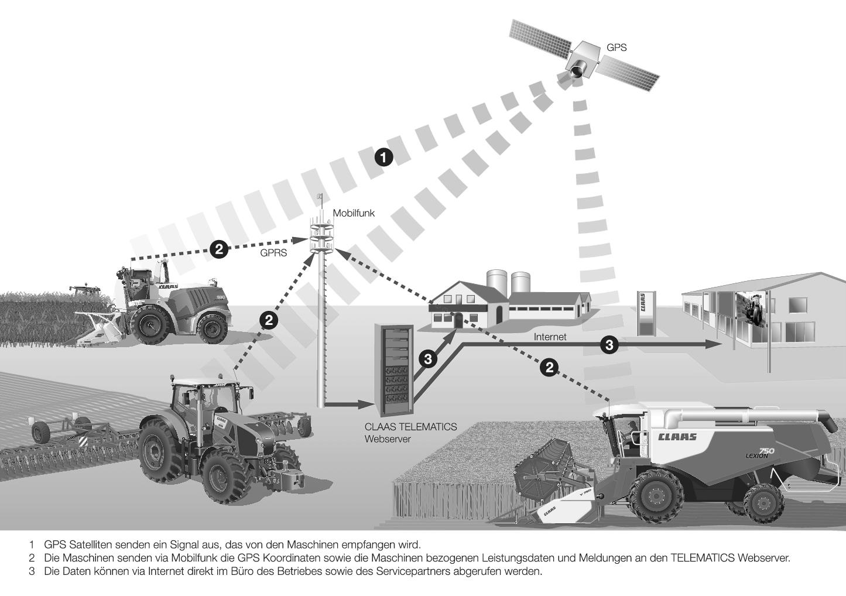
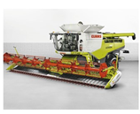
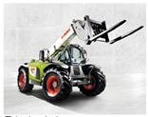
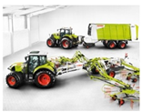
Claas is a pioneer in digital farming, constantly thriving to develop new product and service opportunities for their customers
Claas Service- & Product-Portfolio
Machine control & performance optimization out of the cabin
Productivity increase directly in the field
Software based solutions and data based services for the concern
Machine control and remote diagnostics
Source: Claas & FIR (2015)

Slide 7
Claas defined three major fields of action for Service- & PSS-Engineering
Three fields of action for Service- & PSS-Engineering
The product and service portfolio is increasingly deeper integrated into the value system of the customers – complete new service offers can result.
Information & Communication technology are omnipresent, the availability of any information is technically feasible.
Planning philosophy, Self-control and optimization to handle complexity in such Value-Adding Networks become more powerful.
Business model and Business Architecture
2020
2025
2015
System Integration
System Integration
Value creation system
2015
2015
2020
2020
2025
2025
System Integration
Technologies for information, communication and sensors
Planning philosophy, systems and treatments
Source: Claas & FIR (2015) based on Gudergan et al. (2013)

Slide 8
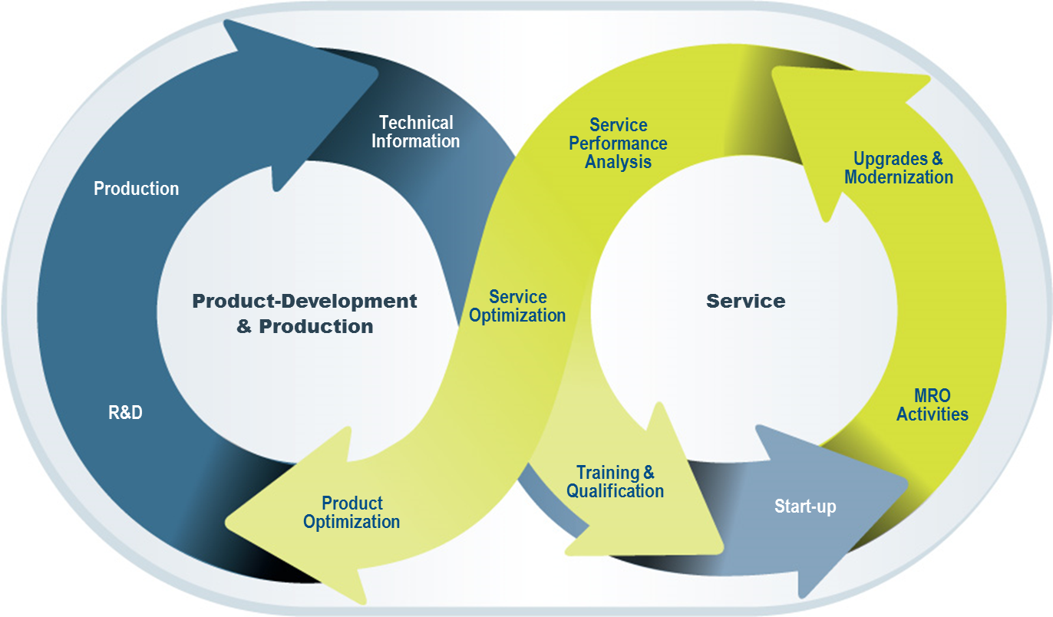
What are the key factors of a Product-Service Lifecycle Systems, in order to make best use of information both from customers and service technicians?
Phases of Product Service Systems
Imagine
Definition
Realization
Use & Support
Retiring / Dispose
Source: Stark (2011); PTC (2013)

Slide 9
Product-Service performance defined by two variables: Efficiency and innovation
Singular adaptive
dual
high
Innovation Capability
reactive
Singular mechanistic
low
low
Service Excellence
high
Innovation Capability
Service Excellence
Ability to develop new innovative business opportunities (explorative perspective)
Ability to reach a high level of service excellence and thus to be service efficient (exploitive perspective)
Source: Sutcliffe et al. (2000)

Slide 10
Agenda
1
FIR Institute - Introduction
2
Motivation
3
Research Model & Findings
4
Summary & Outlook

Slide 11
Based on the Research question, an appropriate scientific approach was conducted
Research question
Which factors of information exchange in a product service system do positively influence the performance of a service oriented organization?
General Approach
Data acquisition based on a questionnaire in the German manufacturing industry.
Surveys where send to responsible employees from the service department.
The questionnaire was structured enquiring general information and industry orientation as well as specific dimensions of the service business, in particular the underlying service business model and its underlying success factors.
Possible answers were based on four different and disjoint response categories.
72 questionnaires were evaluable and used for further empirical analysis.
Formulation of 10 hypotheses to identify relevant success factors .
Regression analysis based on given data pool.
Analysis based on hypothetic constructs under use of a linear multiple regression analysis.
Applied scales were approved using an explorative factor analysis.
Hypothesis were tested regarding their influence on both performance dimensions.

Slide 12
Our research model postulates 10 Hypotheses with a positive impact and organizational performance
Success Dimensions
Performance Dimensions
1. Generate product information on the basis of engineering efforts.
2. Integrate product and service information for training and qualification issues.
… efficiency in service excellence.
3. Acquire information from service.
4. Integrated central product & service history.
5. Extent of information quality.
Impact on …
6. Distribute information from service
7. Analyze changes of service requirements
… development of new products or
business opportunities
8. Analyze changes of product requirements
9. Implement changes of service requirements
10. Implement changes of product requirements

Slide 13
Empirical evidence: we could confirm five out of 10 hypotheses with a (highly) significant impact
Service Efficiency (exploitative)
New business opportunities (explorative)
Sigma-Value < 0,05 -> highly significant; Sigma-Value < 0,1 -> significant

Slide 14
Agenda
1
FIR Institute - Introduction
2
Motivation
3
Research Model & Findings
4
Summary & Outlook

Slide 15
Findings & Outlook
Findings
Based on the questionnaire in the German manufacturing industry, we were able to identify five success factors that have a positive influence on organizational performance.
Generate product information based on engineering efforts.
Acquire information from service.
Extend of information quality.
Use of an integrated central product & service history.
Product & service information for training & qualification issues.
Outlook
For further research, we suggest to detail requirements for the design of information systems for Product-Service-Systems
Source: PTC (2013)

Slide 16
Thank you for your kind attention - Any questions?

